Slide 1
Argus for public health surveillance
April 2019

Slide 2
Public health surveillance for early detection and response

Slide 3

Guidelines
National procedures for public health surveillance
Notes:
In this slide, replace the picture by the national guidelines for public health surveillance.

Slide 4

Public health surveillance
What is the purpose of public health surveillance?
Notes:
Ask participants about the purpose of public health surveillance.

Slide 5


Public health surveillance
What is the purpose of public health surveillance?
Follow-up
Early detection and response
Notes:
Explain the two objectives of public health surveillance:
Follow-up trends in the number of cases for planning and monitoring.
Early detect cases of epidemic-prone diseases to be able to respond quickly and limit the spread of outbreaks.
Depending on these two objectives, the modalities to perform public health surveillance will vary.

Slide 6

Reporting frequencies
Immediate reporting
Weekly aggregated reporting
Monthly aggregated reporting
Notes:
Replace the picture by the national guidelines for public health surveillance.
There are three main different frequencies for data reporting, explain why different diseases/syndromes are reported with different frequencies:
Immediate reporting: diseases and syndromes for which one case may signal an outbreak and for which immediate control measures are needed to prevent the spread of the disease (high transmibility diseases or highly pathogenic diseases such as acute flacid paralysis, acute watery diarrhea with deshydratation, hemorragic fever).
Weekly aggregated reporting: for diseases and syndromes with an epidemic potential, for which the number of cases must be closely monitored to detect an outbreak as soon as possible but which may present sporadic cases or are endemic in the area (e.g. meningitis, acute jaundice syndrome).
Monthly aggregated reporting: for diseases and syndromes that don’t pose an epidemic risk and for which control measures can wait a few weeks to avoid further spread, their surveillance is mainly for programmatic and planing purposes (e.g. chronic disease such as diabetes mellitus, malaria in endemic areas, AIDS).

Slide 7
Early detection and response
Detect as soon as possible an acute public health event and respond to it:
Decrease the number of affected people.
Decrease the negative health consequences.
Decrease the resources needed to respond.

Slide 8


Early detection and response
Detect as soon as possible an acute public health event and respond to it:
Decrease the number of affected people.
Decrease the negative health consequences.
Decrease the resources needed to respond.
Notes:
Infographics to show that the sooner the alert is triggered, the sooner the control measures are put in place, and the less impact the outbreak will have.
green people are healthy people, red people are sick

Slide 9
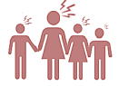
Early detection and response
Detect as soon as possible an acute public health event and respond to it:
Decrease the number of affected people.
Decrease the negative health consequences.
Decrease the resources needed to respond.
9
Notes:
Infographics to show that the sooner the alert is triggered, the sooner the control measures are put in place, and the less impact the outbreak will have.
Green people are healthy people, red people are sick and people with red cross are dead:
- Without detection and response: everyone is infected with 9 deaths.
Detection and response: 10 persons are infected with 3 deaths.
Early detection and response: 5 persons are infected, no death.

Slide 10



Early detection and response
Detect as soon as possible an acute public health event and respond to it:
Decrease the number of affected people.
Decrease the negative health consequences.
Decrease the resources needed to respond.
10
Notes:
Infographics to show that the sooner the alert is triggered, the sooner the control measures are put in place, and the less impact the outbreak will have.
For example here, the loudspeaker represent the first detection and response to the outbreak, green people are healthy people, red people are sick and people with red cross are dead:
- Without detection and response: everyone is infected with 9 deaths.
Detection and response: 10 persons are infected with 3 deaths.
Early detection and response: 5 persons are infected, no death.

Slide 11
Early detection and response
Detect as soon as possible an acute public health event and respond to it:
Decrease the number of affected people.
Decrease the negative health consequences.
Decrease the resources needed to respond.
Notes:
Infographics to show that the sooner the alert is triggered, the sooner the control measures are put in place, and the less impact the outbreak will have.
For example here, the loudspeaker represent the first detection and response to the outbreak, green people are healthy people, red people are sick and people with red cross are dead:
- Without detection and response: everyone is infected with 9 deaths.
Detection and response: 10 persons are infected with 3 deaths.
Early detection and response: 5 persons are infected, no death.

Slide 12
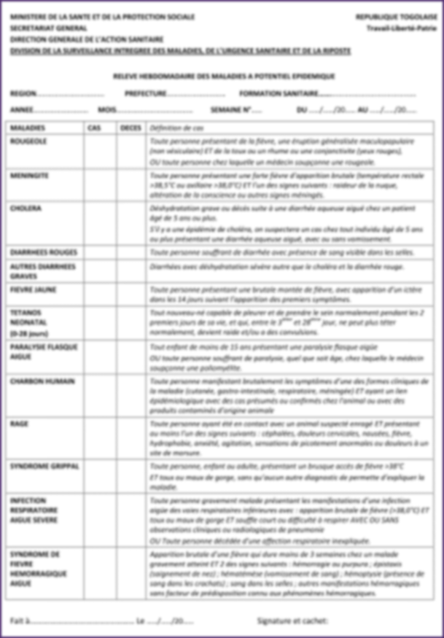
Diseases to be weekly reported
List of diseases and syndromes to be weekly reported
Weekly reporting form
Notes:
Replace the picture by the weekly reporting form used in the country to collate from the register the number of cases and deaths of epidemic prone diseases.
List of diseases and syndromes to be reported weekly in the country:
Only epidemic prone diseases should be on the list, there should no be more than 8-12 diseases on the list.
Only the number of cases and deaths should be reported for each disease/syndrome on the weekly reporting from.
Weekly reporting form to be used in the country:
This paper form is to be used to facilitate data collection from the healthcare facility registry.
The paper form will be the template to report with Argus though SMS.
The form should then stay at the healthcare facility level and archived.

Slide 13
Case definitions / Zero reporting
Why do we use standardized case definitions?
Why still report 0 when there is no case?
Notes:
Put examples of some national case definitions.

Slide 14
Case definitions / Zero reporting
Why do we use standardized case definitions?
Be sure everyone is counting the same disease or syndrome.
Why still report 0 when there is no case?
Distinguish between no case and no information.
Notes:
Put examples of some national case definitions.

Slide 15
Thresholds
Alert thresholds are defined for some diseases/syndromes to be reported
When the threshold is reached, urgent assessment of the situation is needed to implement control measures.
Notes:
Put the alerts tresholds defined in the country for diseases/syndromes to be weekly reported (e.g. 2 cases of meningitis per week for an healthcare facility).

Slide 16
Questions?
Any question on the objectives and modalities for immediate and weekly public health surveillance?

Slide 17
Argus tool for reporting

Slide 18
Purpose of Argus
Detect and respond to outbreaks earlier
Healthcare facilities can send weekly reports and alerts through SMS using the mobile phone.
All levels of the surveillance system can view and validate reports through the internet.
All levels of the surveillance system can view and the epidemiological situation in their area and in the country through the unternet.
Notes:
The objective is to facilitate the data reporting and data management to detect and respond to outbreaks earlier.

Slide 19
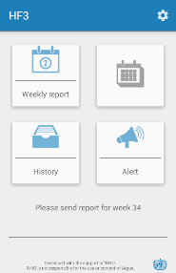
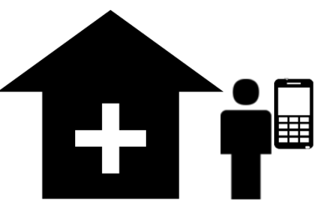

Structure of Argus
Healthcare facility – Argus Android
Send weekly reports
Send alerts
Notes:
Healthcare facilities are in charge of sending their weekly or monthly aggregated reports using Argus on their Android phones.
They can also send alerts of serious or unexpected public health events, alerts will be directly forwarded to the personnal mobile phones of their supervisors.

Slide 20
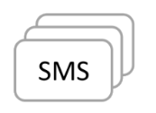


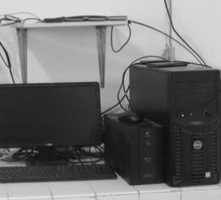
Structure of Argus
Network operator
Forward SMS between healthcare facilities and central server
Healthcare facility – Argus Android
Send weekly reports
Send alerts
Notes:
Weekly reports and alerts are sent through SMS to a central server located at the ministry of Health.
When the central server receives SMS it sends back SMS to the healthcare facilities to confirm reception.

Slide 21
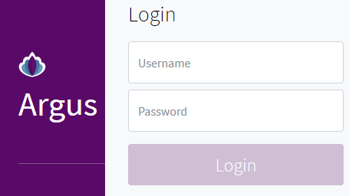
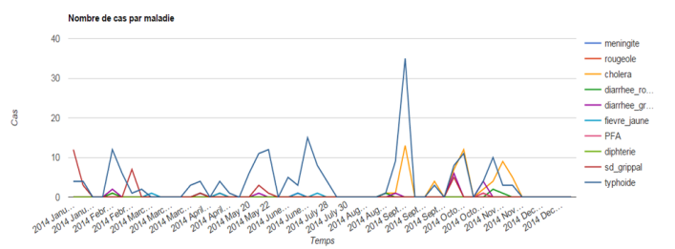
Structure of Argus
Central server – Argus web interface
Collection and aggregation of data
Data visualization, validation, analysis
Automatic weekly epidemiological summaries
Network operator
Forward SMS between healthcare facilities and central server
Healthcare facility – Argus Android
Send weekly reports
Send alerts
Notes:
The central server puts online an Argus website to allow all levels of the surveillance system to view the reports, validate them, view the epidemiological situation and perform custom analyses.

Slide 22
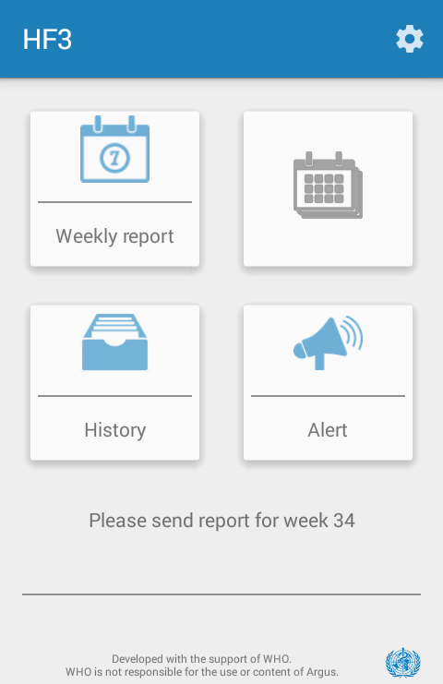

Argus mobile application
Home screen
Name of the healthcare facility
Edit and send weekly reports
Edit and send monthly reports
Review sent reports and alerts and check for reception status
Send alerts

Slide 23
Questions?
Any question on the Argus mobile application?

Slide 24
Activity – Use Argus phone

Slide 25
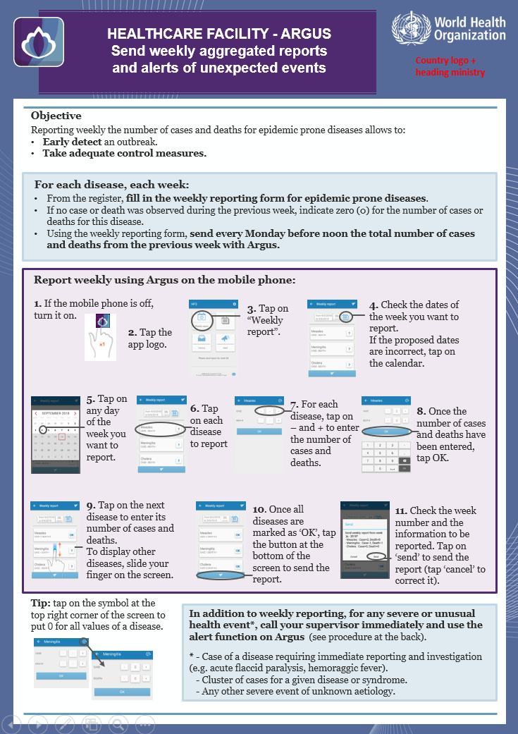
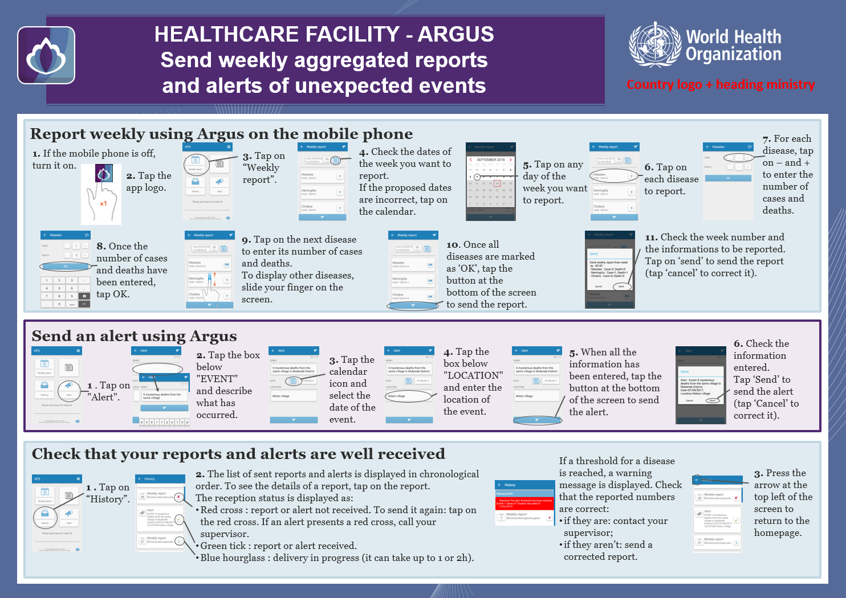
Argus phone
To be used to send alerts and weekly reports to the surveillance system.
Brochure and instruction document
Notes:
Copy-paste the brochures and instructions documents provided to the users.
In the following slides, the activity is to provide each user with the brochure/instruction document on how to use Argus and ask them to complete the following tasks:
Turn-on the phone.
Send a weekly report.
Check the weekly report has been received.
Identify that an alert threshold has been reached.
Send an alert.
Check the alert has been forwarded.
Troubleshooting.
Take time to have a practical session to ensure each user feels comfortable to perform the above mentioned tasks.

Slide 26
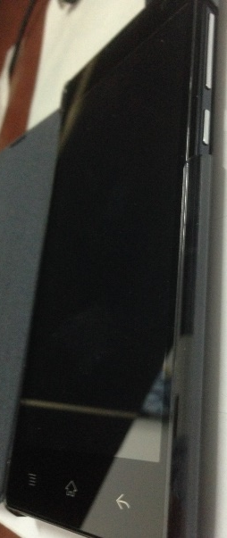
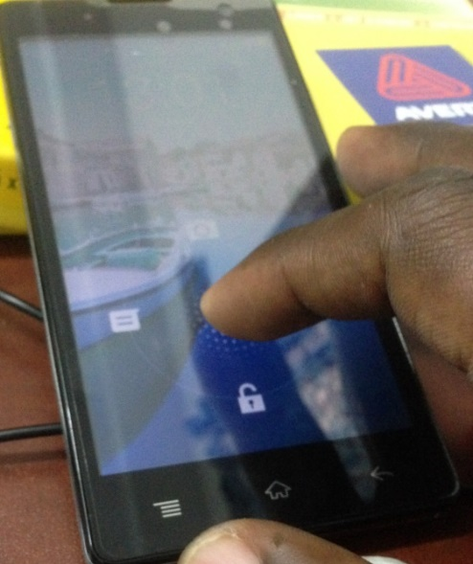
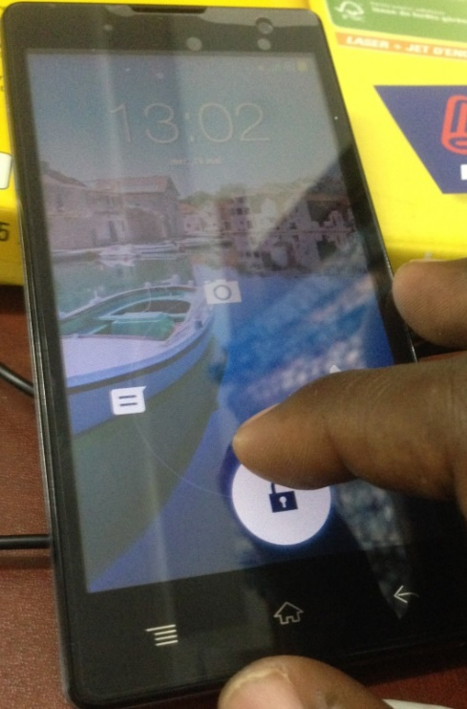
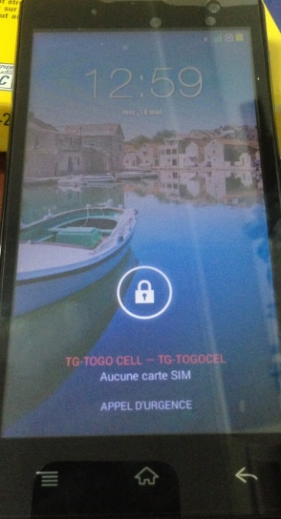

Turn on the phone
To turn on the phone:
Long press, 3-4 seconds
To wake up the phone:
Short press, 1 second
To unblock the phone
Notes:
Adapt the slide to the phone model used in the country.

Slide 27
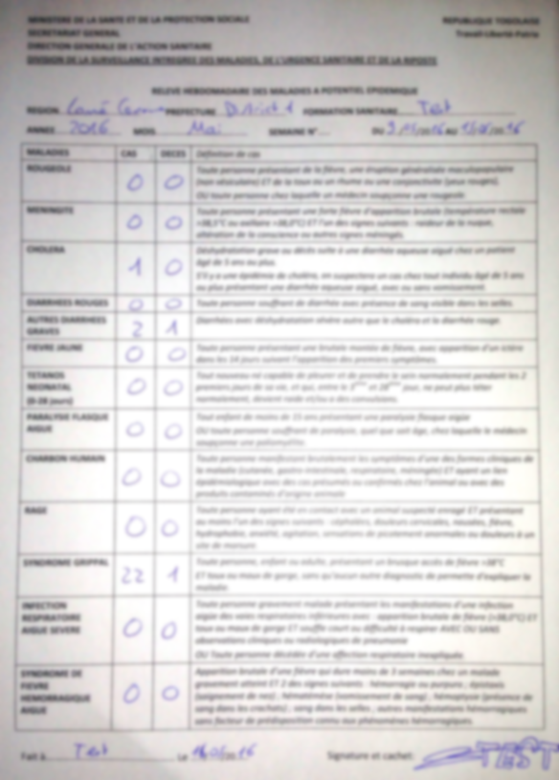
Send a weekly report
Notes:
Put on the slide a completed weekly report form.
Participants have to follow the instructions and use the mobile phone to send the weekly report on the screen with Argus.

Slide 28
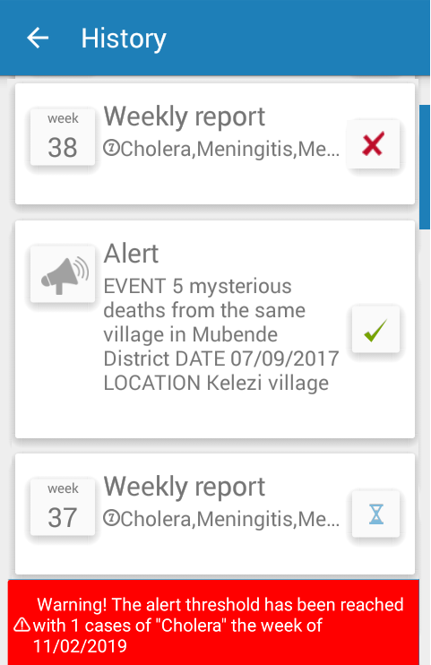
Check report reception
Review sent reports and check for reception status
Report not received
Report received
Report sent, reception not confirmed
Alert threshold reached
Notes:
Ask participants to follow their instructions to check if the report sent through SMS has been well received.
Highlight the fact that when a threshold has been reached for one disease they should investigate the situation and check if control measures are needed in liaison with their supervisors.

Slide 29
Send an alert
Yesterday:
Two neighbour families from the same remote village of Boudie started to suffer from acute diarrhoea with vomiting and dehydration.
As of today, eight people are sick and one died.
Send the alert to your supervisor using Argus.
Check its reception status.
After 20mn, the alert has not been received, what do you do?
Notes:
When sending an alert, Argus will forward the alert to the personal mobile phones of a pre-selected list of supervisors.
Ask participants to send the following alert using Argus on the phone, they should follow their instructions document.
Note that on the top-right corner of the Alert screen there is a counter to indicate how many characters can be sent in the alert.
The text on the screen needs to be summarized bu the users and only important information sent using Argus.
If the alert is not received after some delay, users have to call or find another way to contact their supervisors.

Slide 30
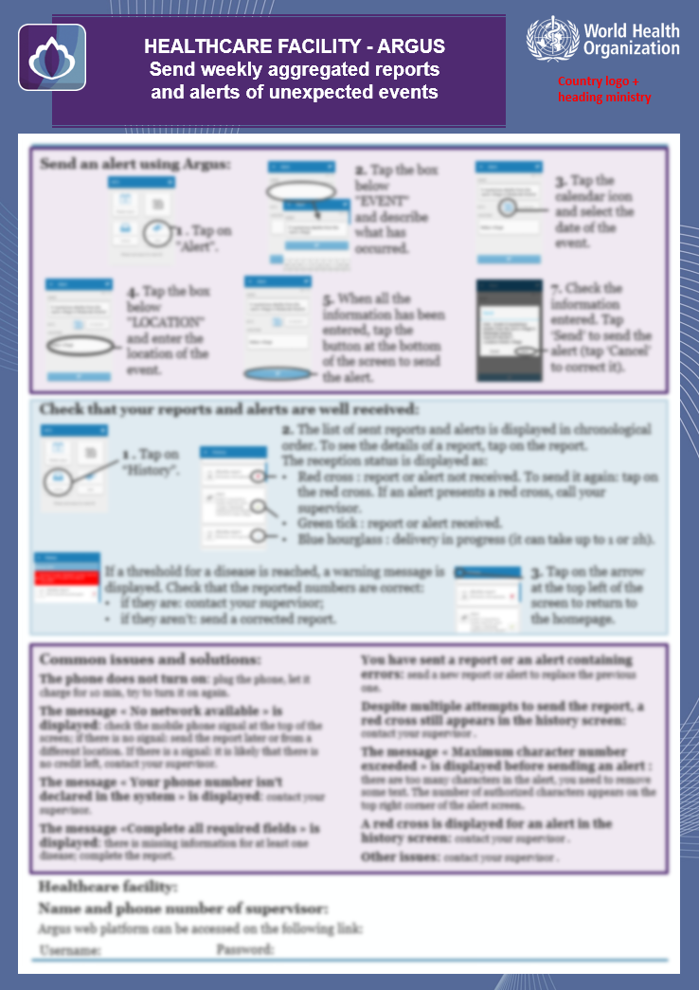
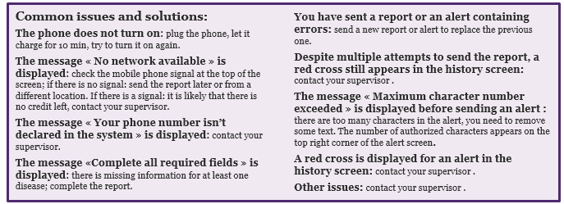
Troubleshooting
Do not hesitate to contact your supervisor.

Slide 31
Questions?
Any question about how to send a reports or alerts with Argus?

Slide 32
Argus web platform

Slide 33
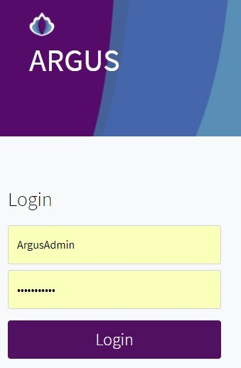

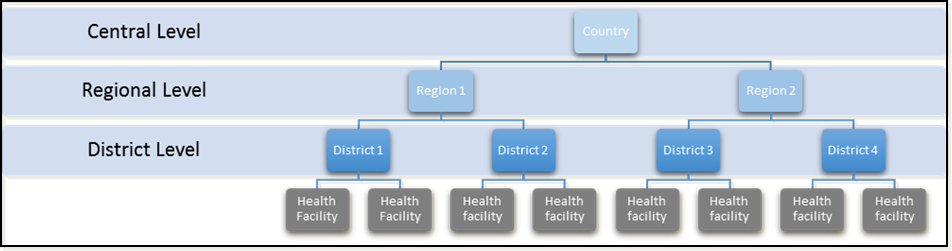
Several levels
User management
Different roles and permission
Management of several levels for data validation / visualization / analysis
Notes:
The main structure within the Argus system is based on a tree hierarchy of “sites”. This hierarchy typically represents the geographical and/or administrative subdivisions within the country:
Reports and alerts are sent from healthcare facilities at the bottom of the hierarchy (peripheral sites).
Data then flow up through the upper level sites (e.g. first through the district, then the region, then it reaches the central level).
At each level of the system, data from weekly or monthly reports are aggregated and validated, for example:
The district will validate or reject reports from its “child” healthcare facilities (i.e. healthcare facilities in its area of responsibility).
An aggregated report for the district is created and is to be validated or rejected by the parent region (i.e. the region in charge of the district).
An aggregated report for the region is created and is to be validated or rejected by the central level.
The number of levels in the system is not limited and depends on the national setting.
The peripheral sites (healthcare facilities) are in charge of sending alerts and weekly or monthly reports through SMS using the Argus application.
The sites at the levels above healthcare facilities are in charge of:
validating or rejecting received reports from their child sites (for example in the figure District 1 and District 2 are the child sites of Region 1);
reviewing the data analyses for their area of responsibility to check if there is any epidemiological threat requiring a rapid response.

Slide 34
Access to the platform
You can access the platform on:
XXXXXXXXXX/argus
Use your username and password
Duties at intermediate and central levels
Validate or reject on time the reports.
Download the weekly epidemiological summary of the area.
Look at the administrative and epidemiological dashboard.
Notes:
Put the correct URL to access your Argus Web Platform.

Slide 35
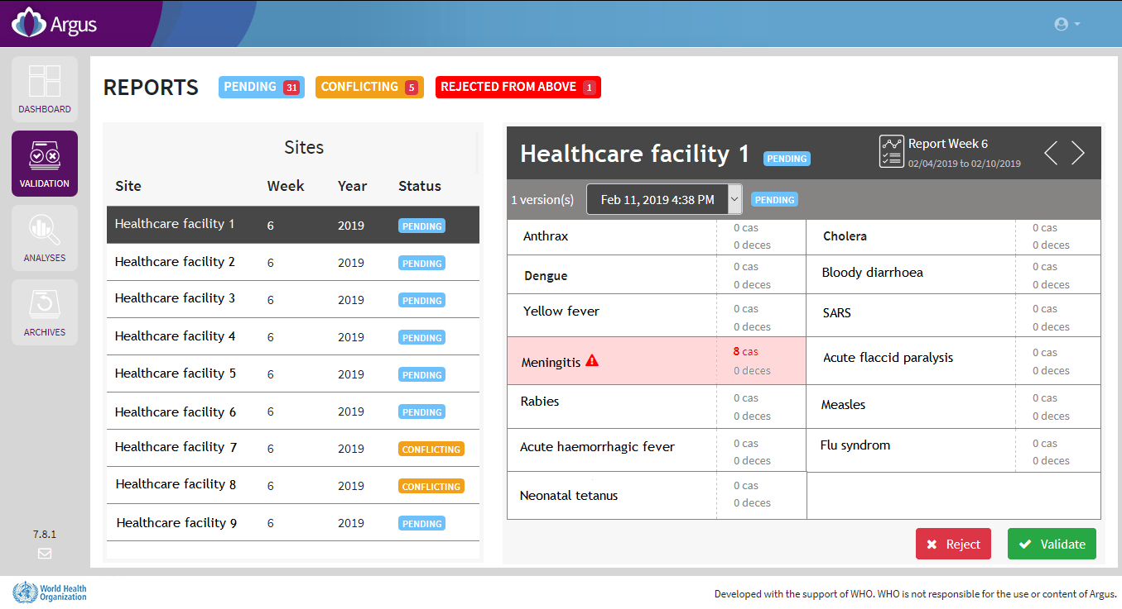
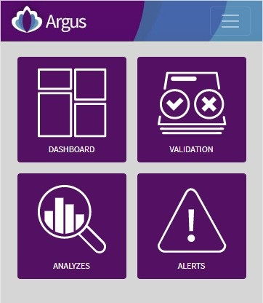
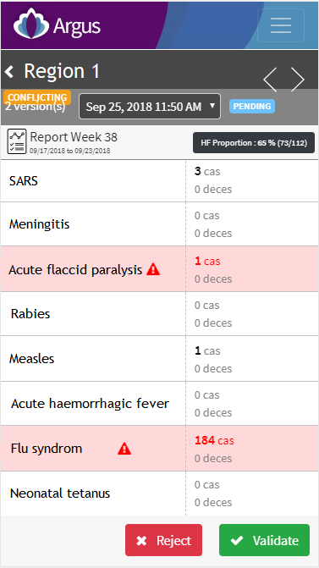
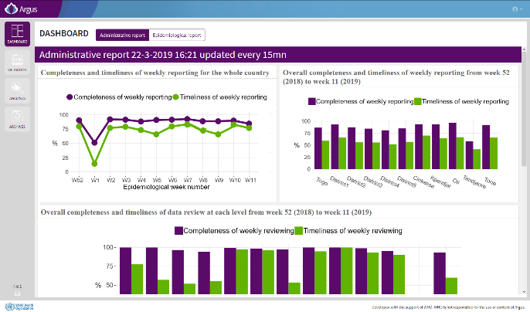
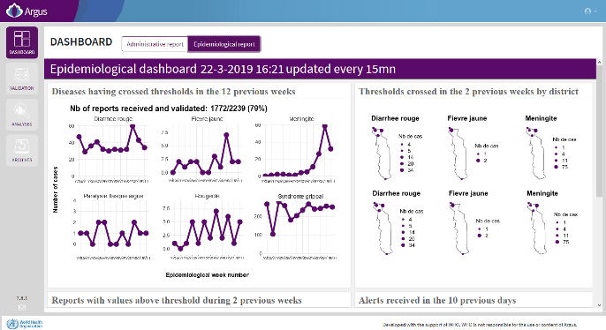
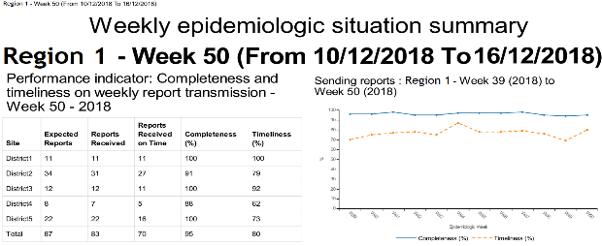
Functionalities
Visualization and validation of data
Automatic weekly epidemiological summary in pdf
Dashboards

Slide 36
Questions?
Any question on the Argus web platform?

Slide 37
Notes:
Put the contact of the resource person for the users.

